Slide 1
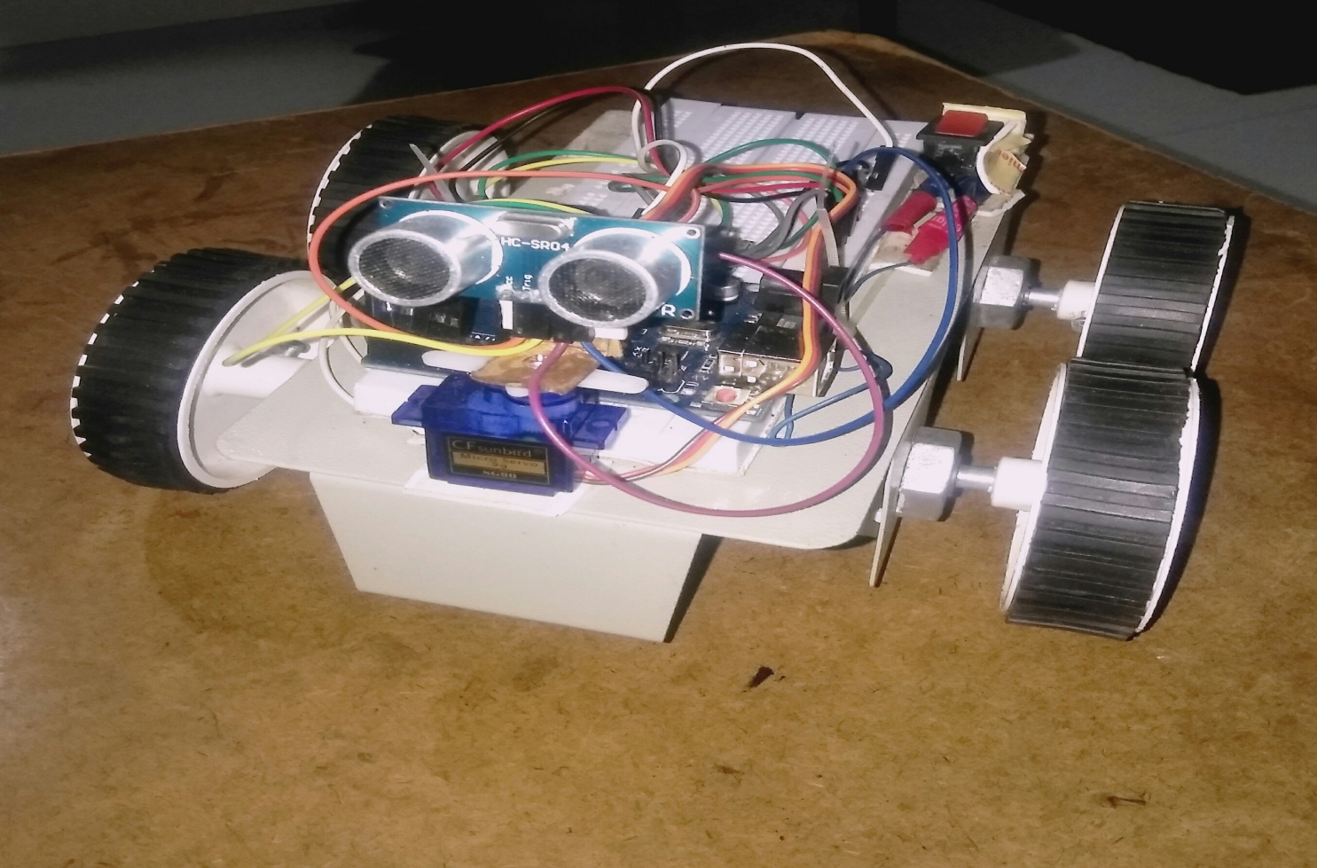
Wireless controlled automobile

Slide 2
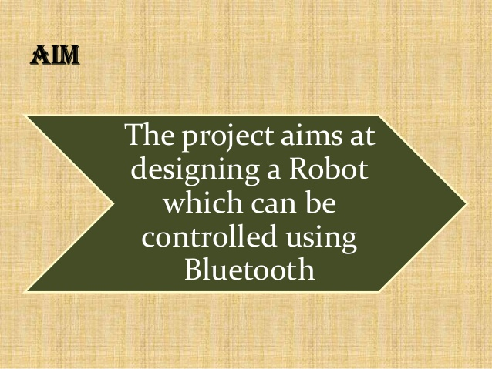

Slide 3
Project overview
*
what ?
→vehicle which can be controlled remotely by an android smart phone app.
*
HOW ???...
→write an android app which allows the user to provide inputs via app…
→the app sends command via blue tooth..
→commands received by blue tooth modem connected to arduino .
→arduino controls the motors based on the user commands ….

Slide 4
COMPONENTS LIST :
:
1→ ARDUINO UNO
2→BLUETOOTH MODULE [HC-05]
3→MOTOR DRIVE [L293D]
4→ dc MOTORS [100RPM]
5→SERVO MOTOR [SG90]
6→ULTRASONIC SENSOR [HC-SR04]
7→CONECTING WIRES [MALE-MALE; MALE-FEMALE]
8→BATTERY [12 V]
9→SWITCH
10→BREAD BOAR
11→TYRES (4)

Slide 5
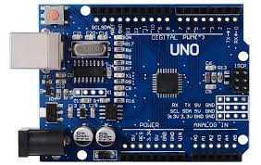
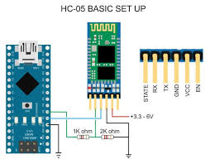
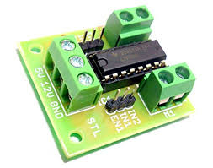
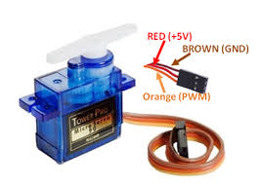
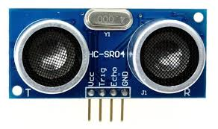
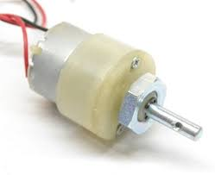
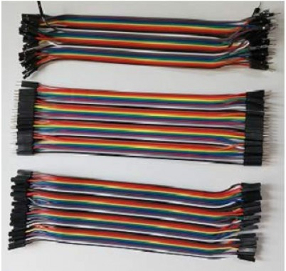
ARDUINO UNO
BLUETOOTH MODULE
L293D MOTOR DRIVE
SERVO SG90
ULTRASONIC SNSOR
100 RPM DC MOTOR
CONNECTING WIRES

Slide 6
PURPOUSE OF EACH COMPONENT
ARDUINO: Used to store the code and it controls the entire process.
L293D:It acts as current amplifier .It controls DC motors simultaneously in both clockwise and anticlockwise direction.
BLUETOOTH MODULE(HC-05):Used for transparent wireless serial connection setup.
ULTRASONIC SENSOR: Used for detecting obstacles ahead and also for automatic control.
SERVO MOTOR: Helps the ultrasonic sensor to change the direction.
blue-tooth module[hu-o5]:- receive the data from app and send that data to arduino.

Slide 7
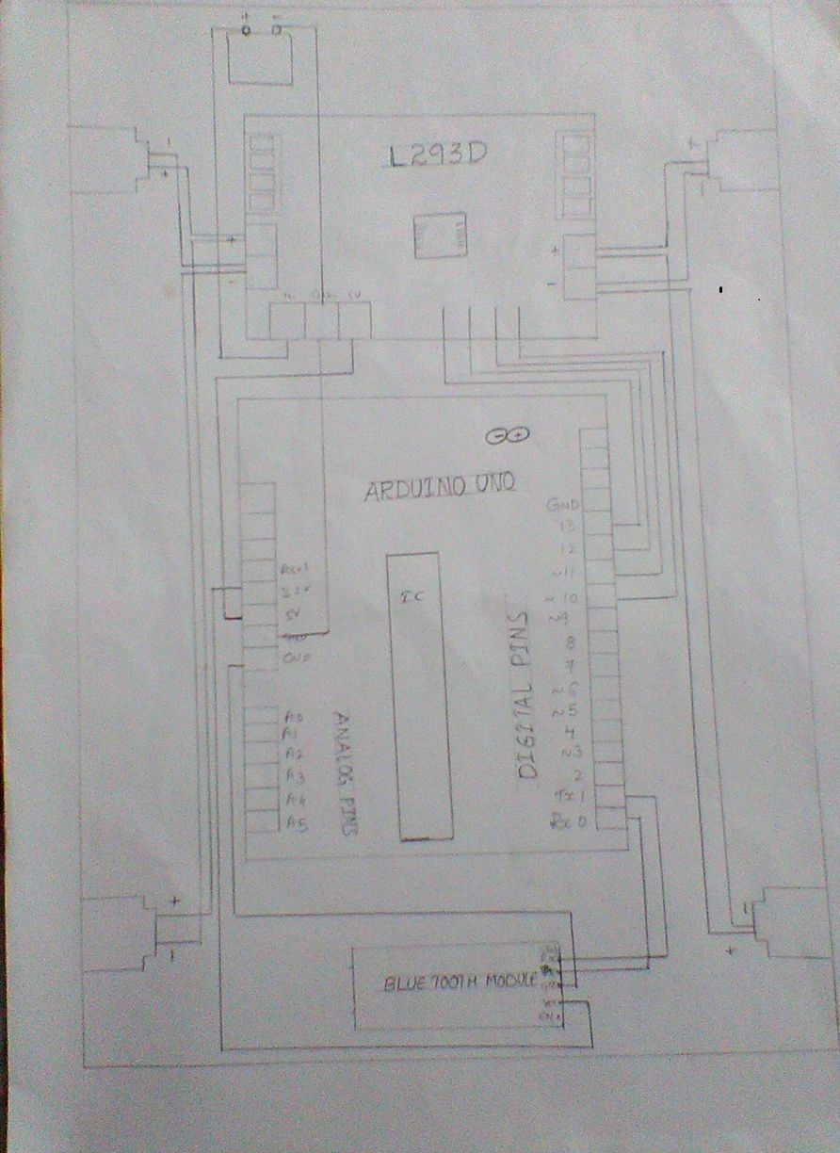
Circuit diagram

Slide 8
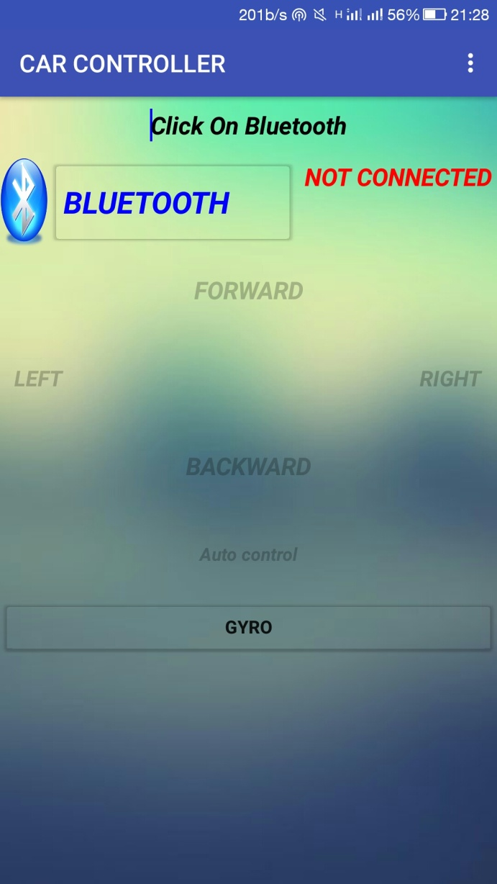
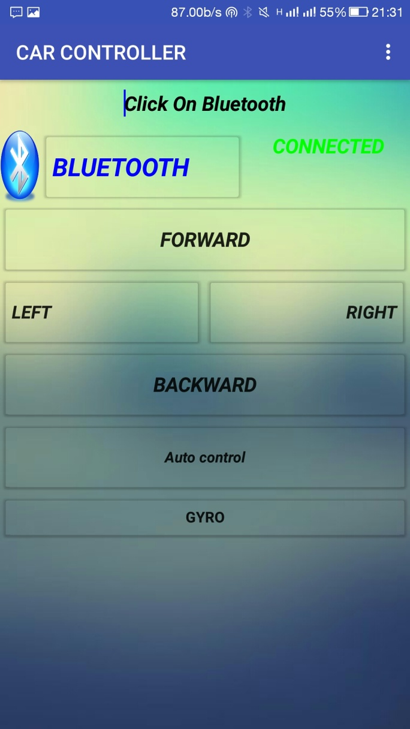
ANDROID APP TO CONTROL CAR
after connecting
Before connecting

Slide 9
PROCESS:
Bluetooth connected to module, user give instructions.
Instructions PASSED TO BLUETOOTH MODULE AND IT PASS THE instructions TO ARDUINO
ARDUINO RECEVIES THE instruction AND EXECUTE THE CODE which is already uploaded..
After receiving THE instructions from blue -tooth module, arduino will send the instruction to motor drive
MOTOR DRIVE SEND THESE INSTRUCTIONS TO THE DC MOTORS by taking external power supply AND THEY ACT ACCORDINGLY

Slide 10
ABSTRACT:
→automatic control is the use of various control system for operating any equipment or device such as a remote controlled (toy) car .
→other useful applications with minimal or reduced human interventions.
→Arduino Uno , an H-bridge L293D IC for motor controller , and four electric DC motors are used to move the automobile.
The objectives of this project are controlling the car wireless communication system.
→The test result shows that the controlled car can move in any direction.
→However, the performance depends on the device signal strength where the maximum testing range is only about 20 meters’ distance from
the user’s location.

Slide 11
Advantages:
→ ACCIDENTS DUE TO TEMPORARY BLINDNESS ARE AVOIDED.
→ DETECTING AND MONITORING CAR THEFTS.
→we can check speed and communicate with other car.

Slide 12
Disadvantages:
→WE CAN CONTROL THE AUTOMOBILE only WITH IN THE LIMIT
or Boundary AREAS.
Sometimes they may misbehave due to no proper
signal.
→Sensor is only senses the obstacles which are parallel and at same height to the sensor

Slide 13
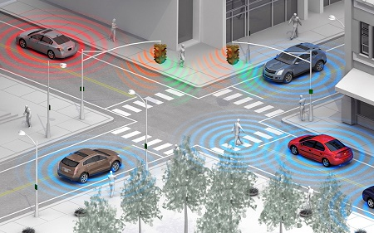
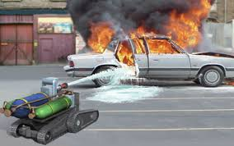
Applications:
→ Vehicle to vehicle communication (V2V)
→ AUTOMATIC SPEED CONTROL
→ Wireless vehicle detection
→fire fighting robotic vehicle

Slide 14
Conclusion:
→Possibilities of wireless technology are limitless and many tests are in progress to support autonomous driving, connected vehicles and smart car technologies. Wireless robots are deployed in the manufacturing plants to support production, increase efficiency and precision. Effective use of modern wireless technologies integrated with automobiles will offer a much convenient and safer road trip in future.

Slide 15

#include<stdio.h>
Void main()
{
Printf(“thank you”);
}
#include<iostream.h>
Void main()
{
Cout<<“ thank you”;
}
Output:
Thank you
Done by-:-
N. Bharadvaj
Bhargavi
Velavarthipati Kasyap
P.Shanmuk
G.O.S Manikanta
A.Rajesh

